Slide 1
A Technical Comparison Between Windows and MacOS Operating Systems
By Chowdhury Jawaad and Muhammad Choudhury

Slide 2
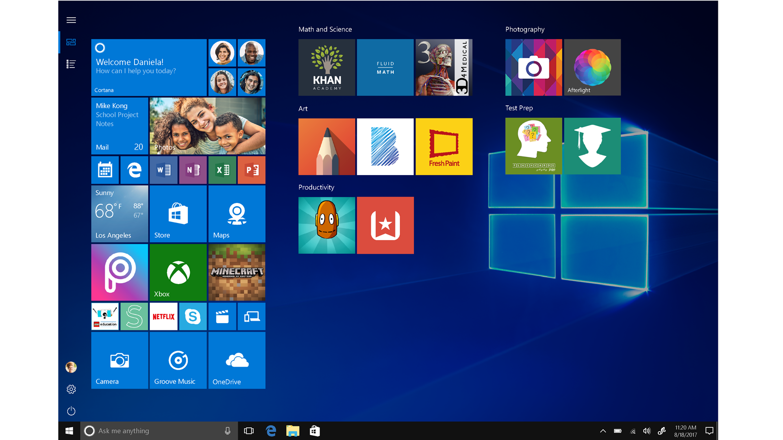
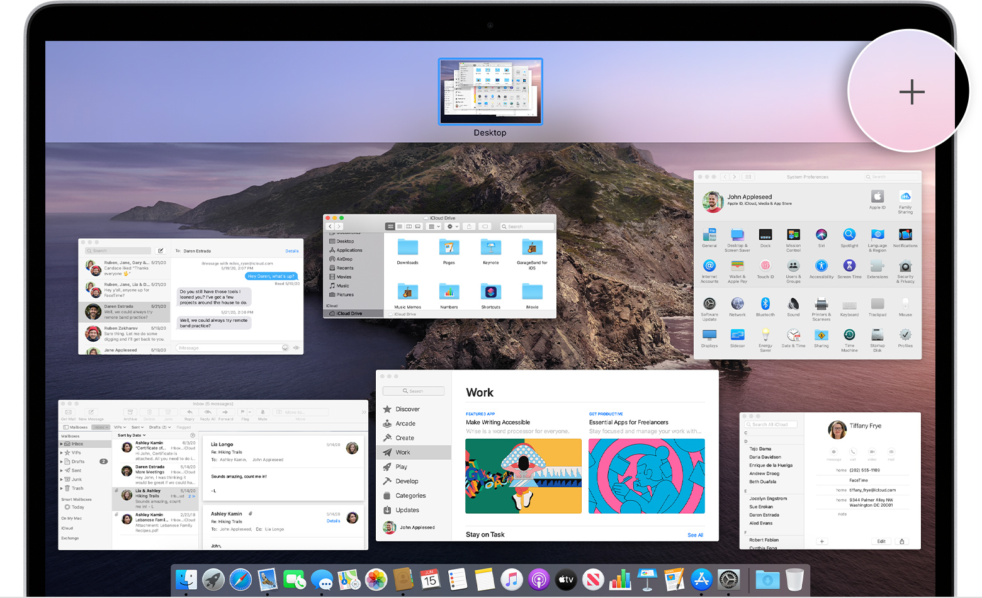
Introduction of Windows and MacOS Operating Systems

Slide 3
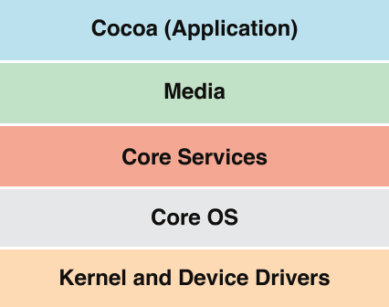
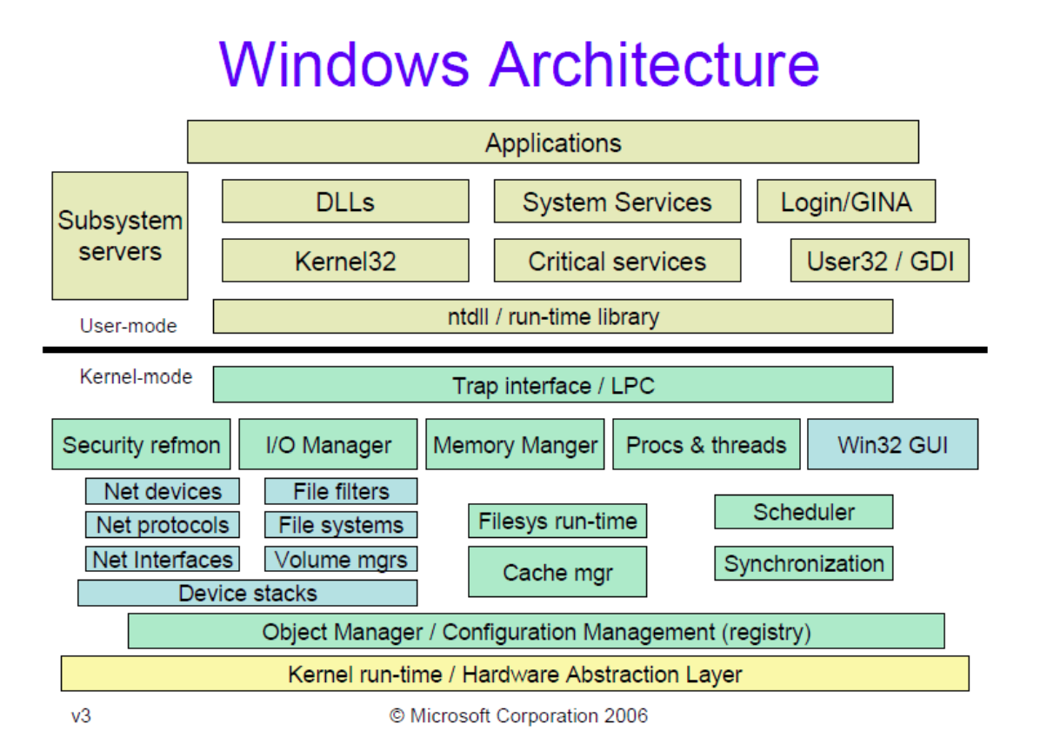
OS Architecture of Windows and MacOS Operating Systems

Slide 4
Threading Features of Windows and MacOS Operating Systems
Threading is supported in MacOS. Every single application starts out with a single thread that will run the applications “main” function. The program will then spawn additional threads that all have their own call stack and will be scheduled separately from other threads by the kernel.
Windows support multiple threads, thread is the entity within a process that is scheduled for execution. Every thread in a process shares a virtual address space and system resources. A process starts with a single thread, but additional threads can be created from the other threads. A thread is able to create a window, and a thread that creates a window also owns all of the associated message queue.

Slide 5
Scheduling Algorithms of Windows and MacOS Operating Systems
MacOS uses a MultiLevel Feedback Queue as a scheduling algorithm with four different levels of priority:
Real-Time Threads
Kernel Mode Only Threads
System-High Priority Threads
Normal Threads
Windows also uses a MultiLevel Feedback Queue as a scheduling algorithm but has 32 priority levels:
Levels 0-15 are have threads with Normal priority. Level 0 is used solely for memory management
Levels 16-31 have real-time priority and are all above threads 0-15

Slide 6
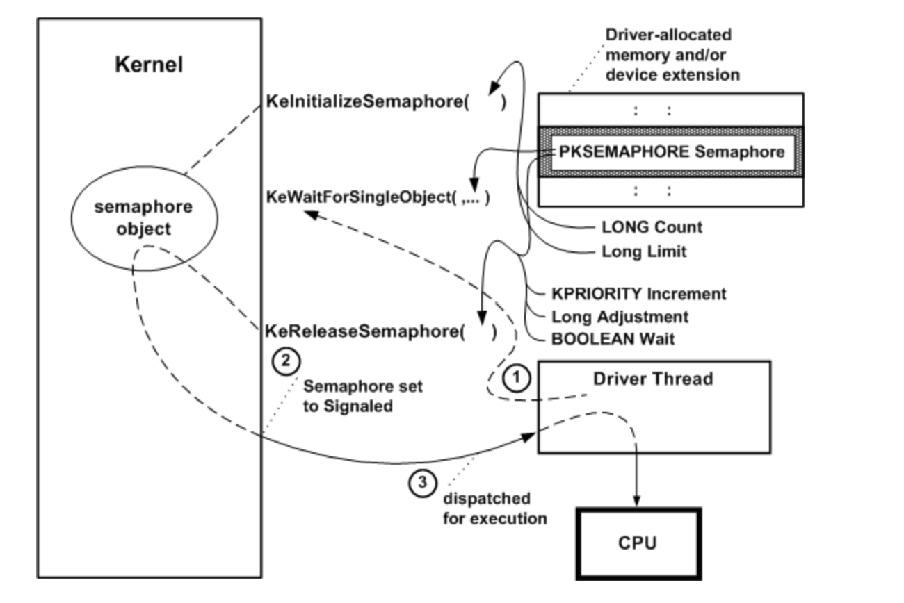
Synchronization Techniques of Windows and MacOS Operating Systems
MacOS uses different forms of synchronization for when it performs CPU Scheduling :
Spinlock
Mutex
Read-Write Lock
Semaphores

Slide 7
Memory Organization and Management of Windows and MacOS Operating Systems
Virtual Memory is used greatly in the MacOS when it comes to the aspect of managing and organizing memory. The VM consists of address spaces and minimizing those contents at the higher level and also consists of memory objects with their own owners and protections at the lower level.
For Windows memory management is taken care by the memory manager, which implements virtual memory and provides a set of services such as memory mapped files, large memory support, and support for cache manager. Each process on 32-bit Microsoft Windows has its own virtual address space that enables addressing up to 4 gigabytes of memory.

Slide 8
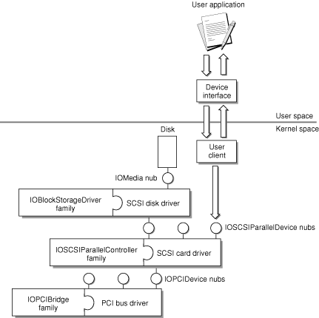
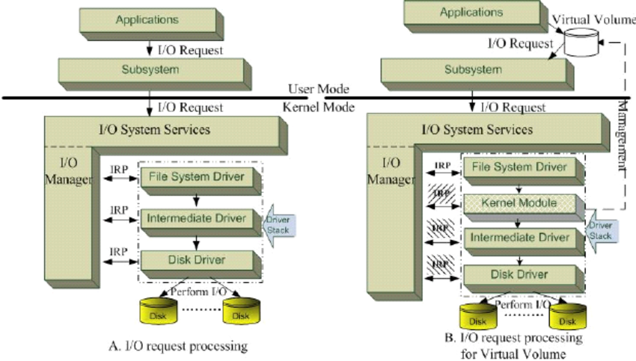
I/O Management of Windows and MacOS Operating Systems

Slide 9
Refrerences
Stallings, William. “The Windows Operating System .” Rossano, Prentice Hall, 2008, rossano.pro.br/fatec/cursos/soii/Windows.pdf
Gerbarg, Louis G. “Advanced Synchronization in Mac OS X: Extending Unix to SMP and Real-Time.” USENIX, BDSCon, 5 Dec. 2001, www.usenix.org/legacy/event/bsdcon02/full_papers/gerbarg/gerbarg_html/
Case, Andrew, and Ryan D Maggio. “Memory Analysis of MacOS Page Queues.” Science Direct, DFRWS USA, July 2020, www.sciencedirect.com/science/article/pii/S2666281720302535
Case, Andrew, and Ryan D Maggio. “Memory Analysis of MacOS Page Queues.” Science Direct, DFRWS USA, July 2020, www.sciencedirect.com/science/article/pii/S2666281720302535
“Windows Kernel-Mode I/O Manager - Windows Drivers.” Microsoft Docs, 17 Oct. 2018, docs.microsoft.com/en-us/windows-hardware/drivers/kernel/windows-kernel-mode-i-o-manager
“Kernel Programming Guide.” Kernel Architecture Overview, Apple, 8 Aug. 2013, developer.apple.com/library/archive/documentation/Darwin/Conceptual/KernelProgramming/Architecture/Architecture.html.

Slide 10
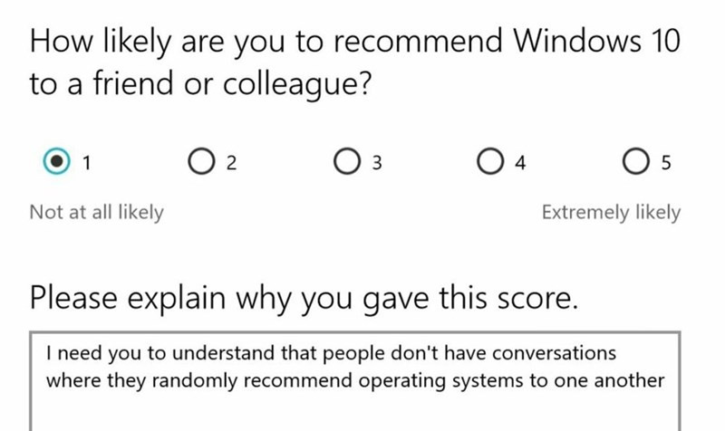
Thank You For Listening!

